Slide 1

Looker Studio Dashboard Guide:
Google Analytics

Slide 2
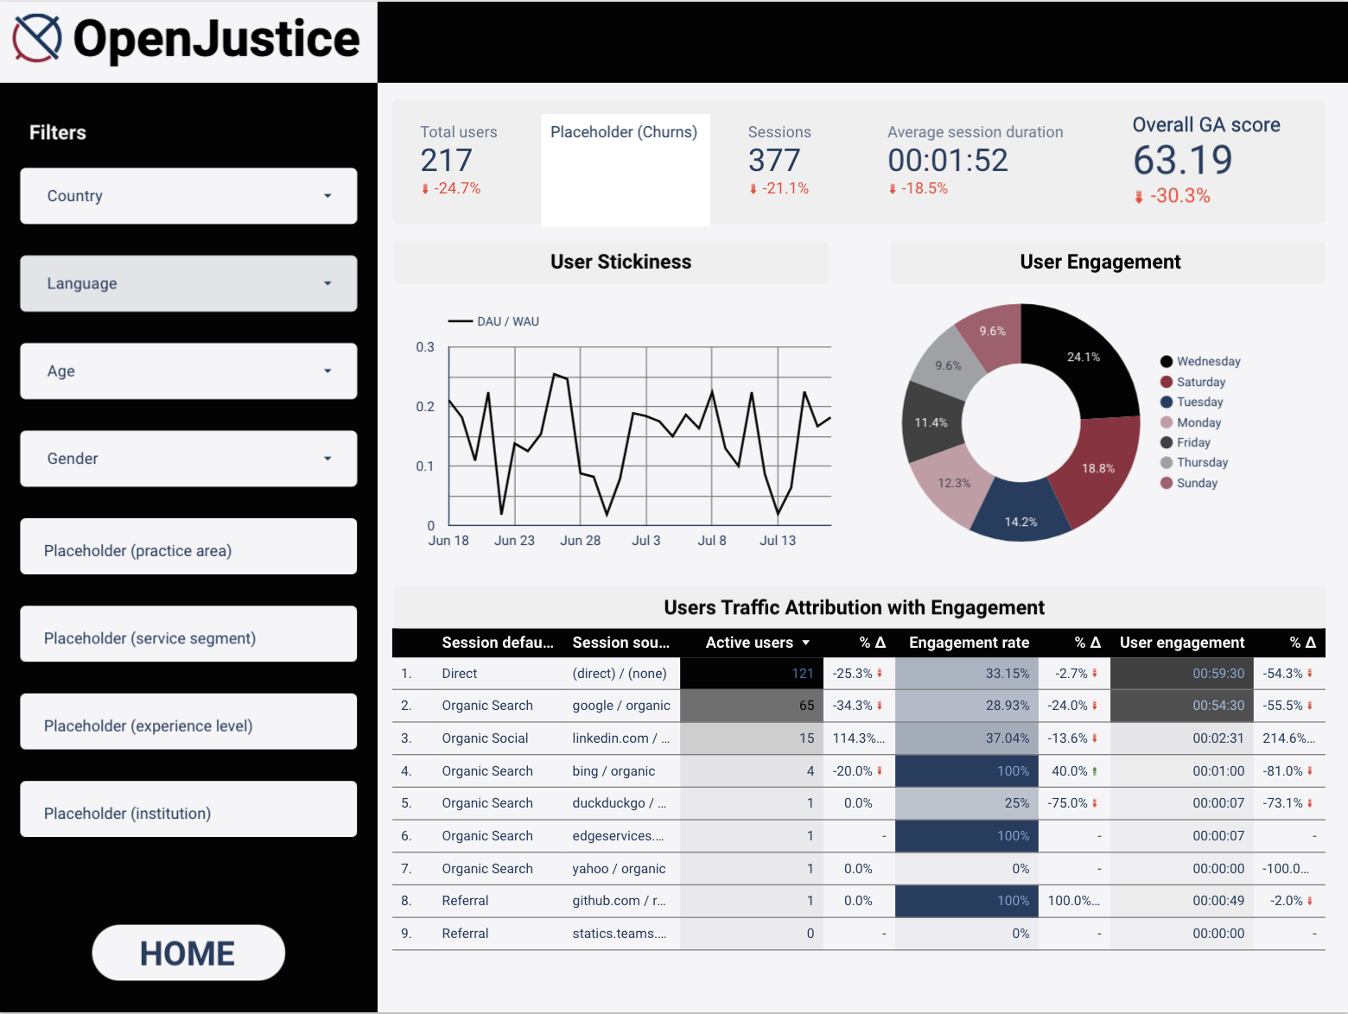
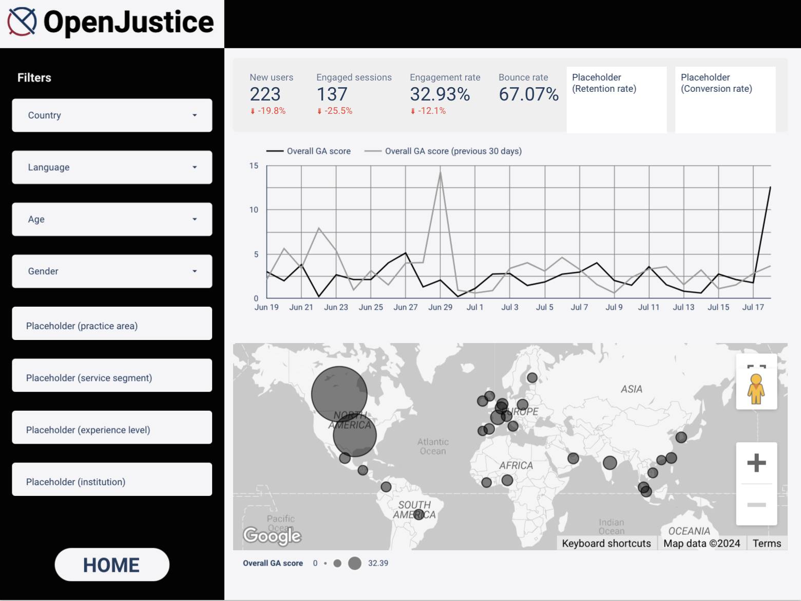
Overview
Other important metrics
Aggregated score breakdown
Link to the dashboard: https://lookerstudio.google.com/reporting/46996a46-3e99-49b5-b038-b1b5b1837740
** Anyone with the link can access and edit

Slide 3
KPIs
Other Metrics
Acquisition KPIs
Number of new users
Engagement KPIs
Bounce rate
Engagement rate
Number of engaged sessions
Conversion KPIs
Conversion rate (NOT implemented yet)
Retention KPIs
Retention rate
Churn rate
Total number of users
Total number of sessions
Average session duration
User stickiness
Total user engagement time
Traffic attribution
User segments (country, language, age, gender, etc.)
Notes:
Reference:
https://aicontentfy.com/en/blog/key-performance-indicators-kpis-for-website-analytics#:~:text=These%20metrics%20help%20measure%20the,and%20optimize%20their%20online%20presence
https://whatagraph.com/blog/articles/website-kpis

Slide 4
Page 1: Overview
Scorecards:
Important metrics that contain data for the past 30 days with a comparison
User stickiness over time:
DAU/WAU shows the percentage of users who engaged in the last 24 hours out of the users who engaged in the last 7 days. A higher ratio suggests good engagement and user retention
2
Filters:
Including all types of segments.
Country and Language are currently available
Age and Gender don't have data stored
Other placeholders are proposed to be included in the future
1
3
4
User engagement by days:
The amount of time users spend with the web page in focus in each day of the week to see the distributions
Traffic attribution for channels:
The breakdown of channel distribution for session traffic
including the number of active users, engagement rate and time with comparisons with the past period
5

Slide 5
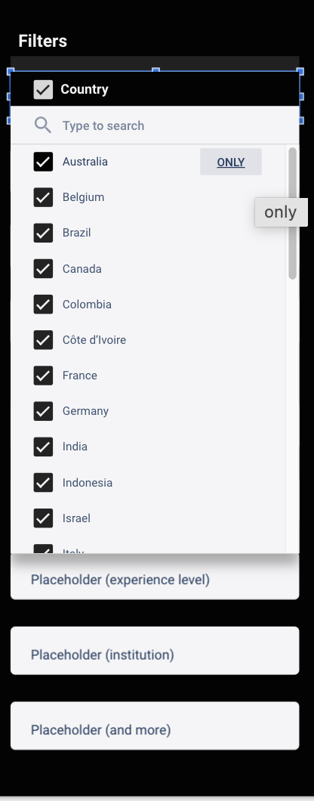
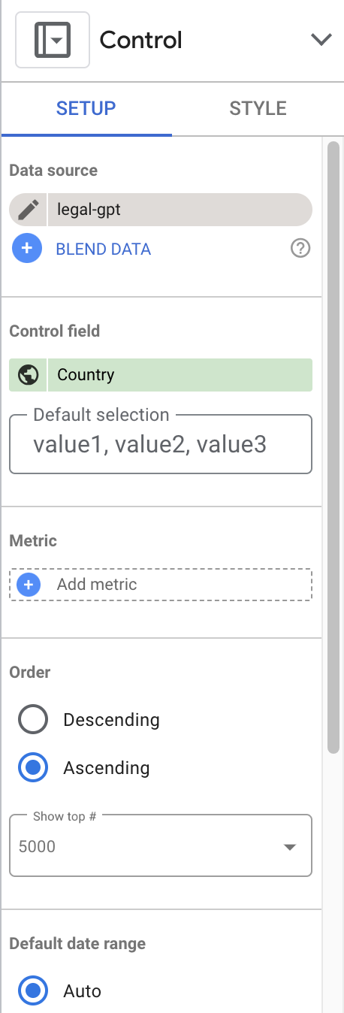
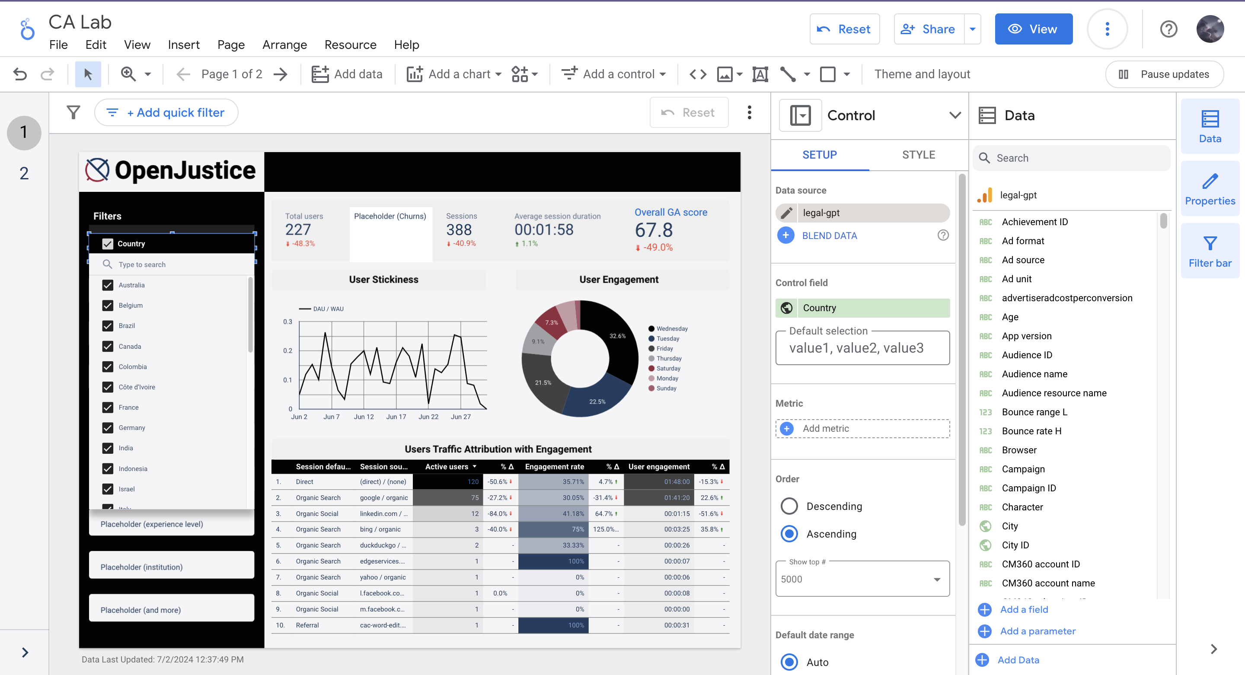
Page 1: Filters
To use:
Click on a certain filter to select the ones you want
Or to select the filter again to clear selections
Change the Placeholders by "Add a control -> Drop-down list" and change the "Control field", no Metric needed
To edit:
There will be a Control bar on the right that allows to make changes to the elements
1

Slide 6
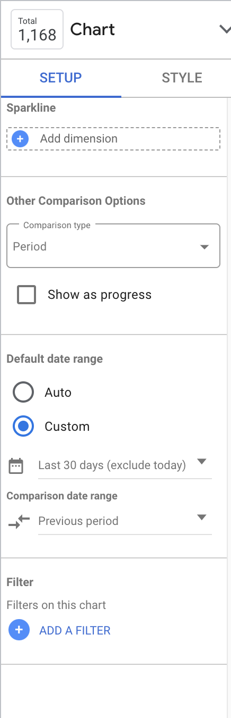
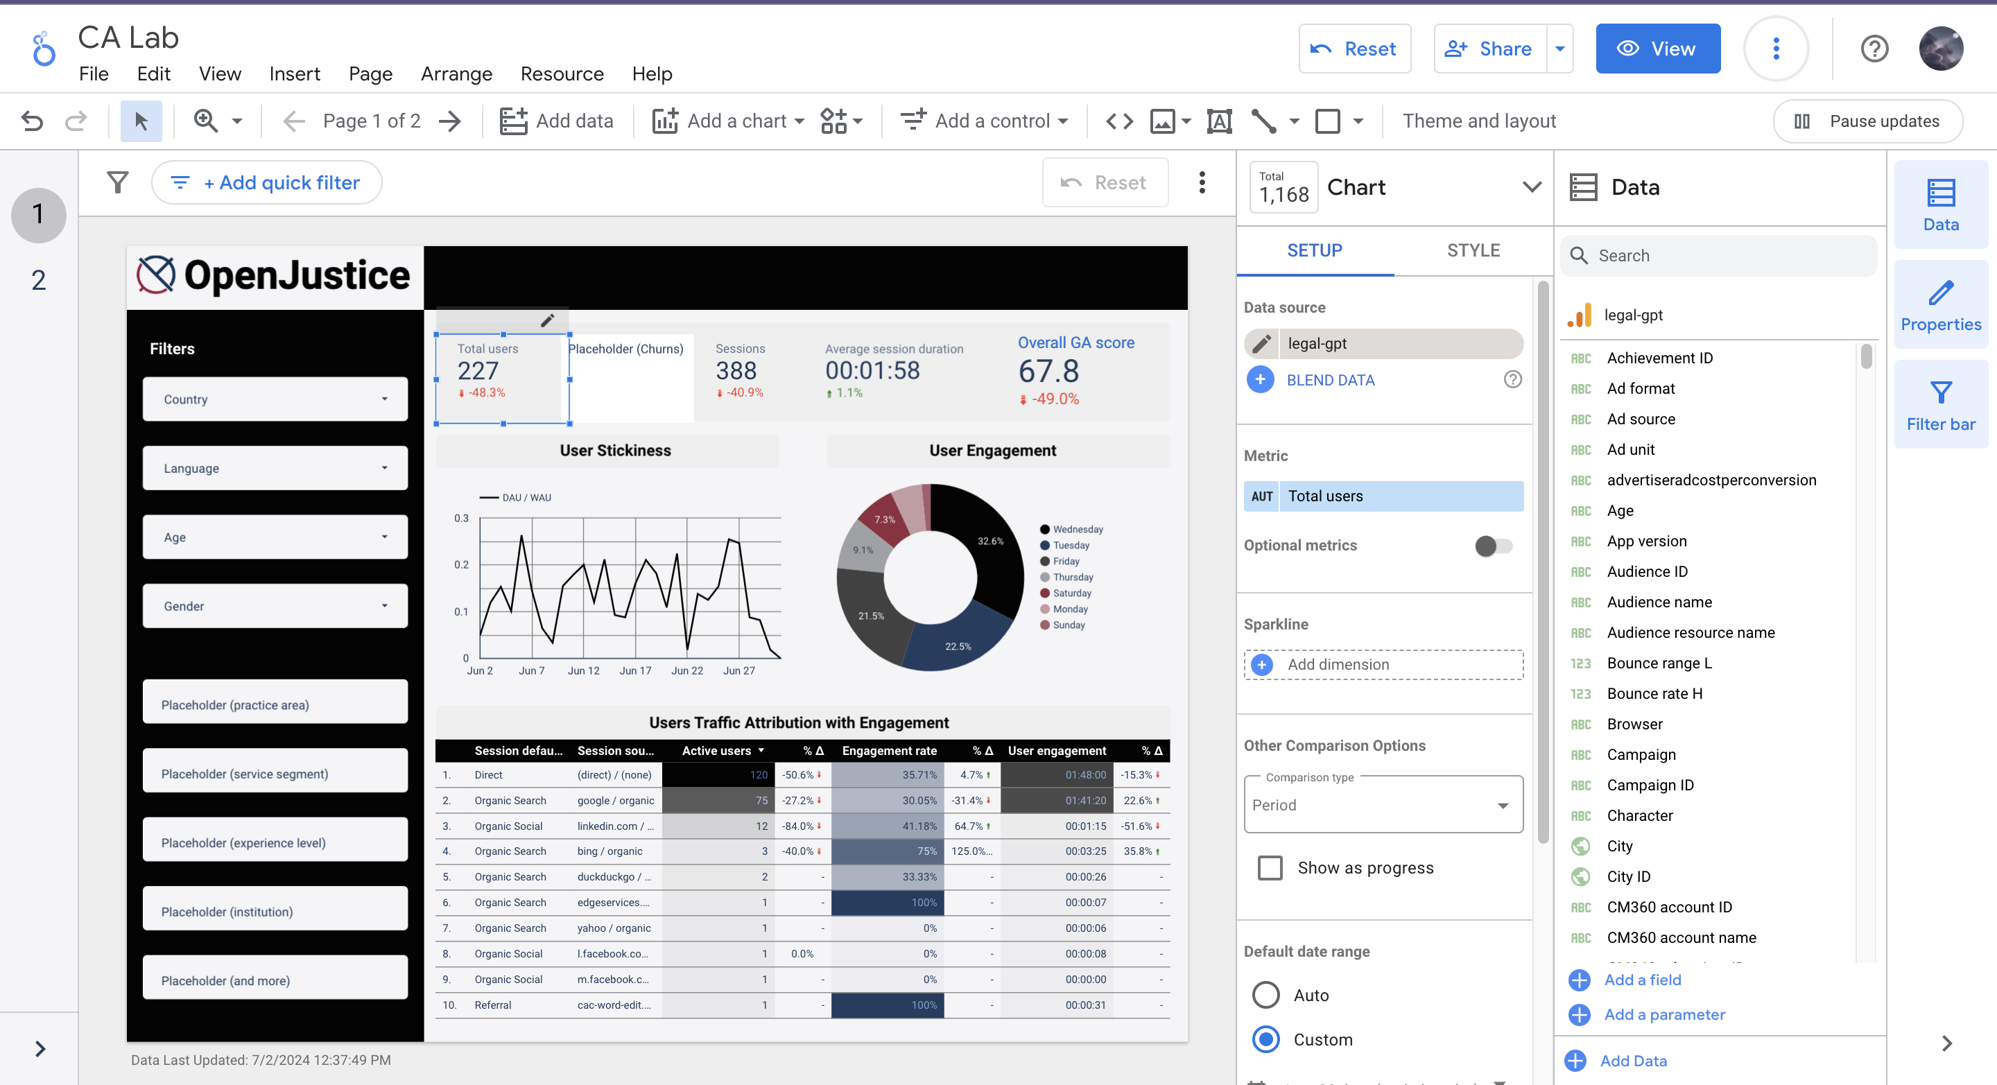
Page 1: Scorecards
Total users
Churn: number of users churning, and it can be used to calculate churn rate in the future (change the placeholder with a Scorecard by "Add a chart -> (1st) Scorecard" in the future)
Sessions: user interactions with the website that take place within a given time frame
Average session duration
Overall GA score: customized aggregation of several KPIs. Clicking on it will lead to the second page
** All the values are now set to the last 30 days, and they can be changed.
To edit:
Total user card as an example to change the time range, on the right Control bar, change "Default date range"
2

Slide 7
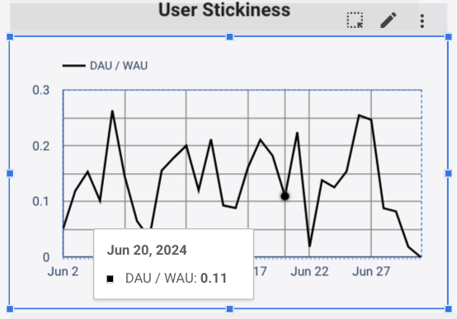
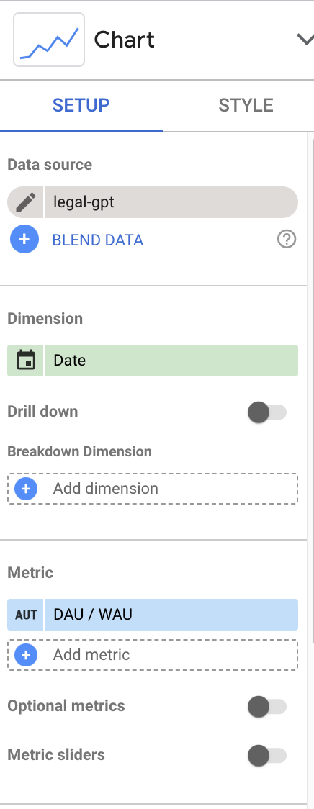
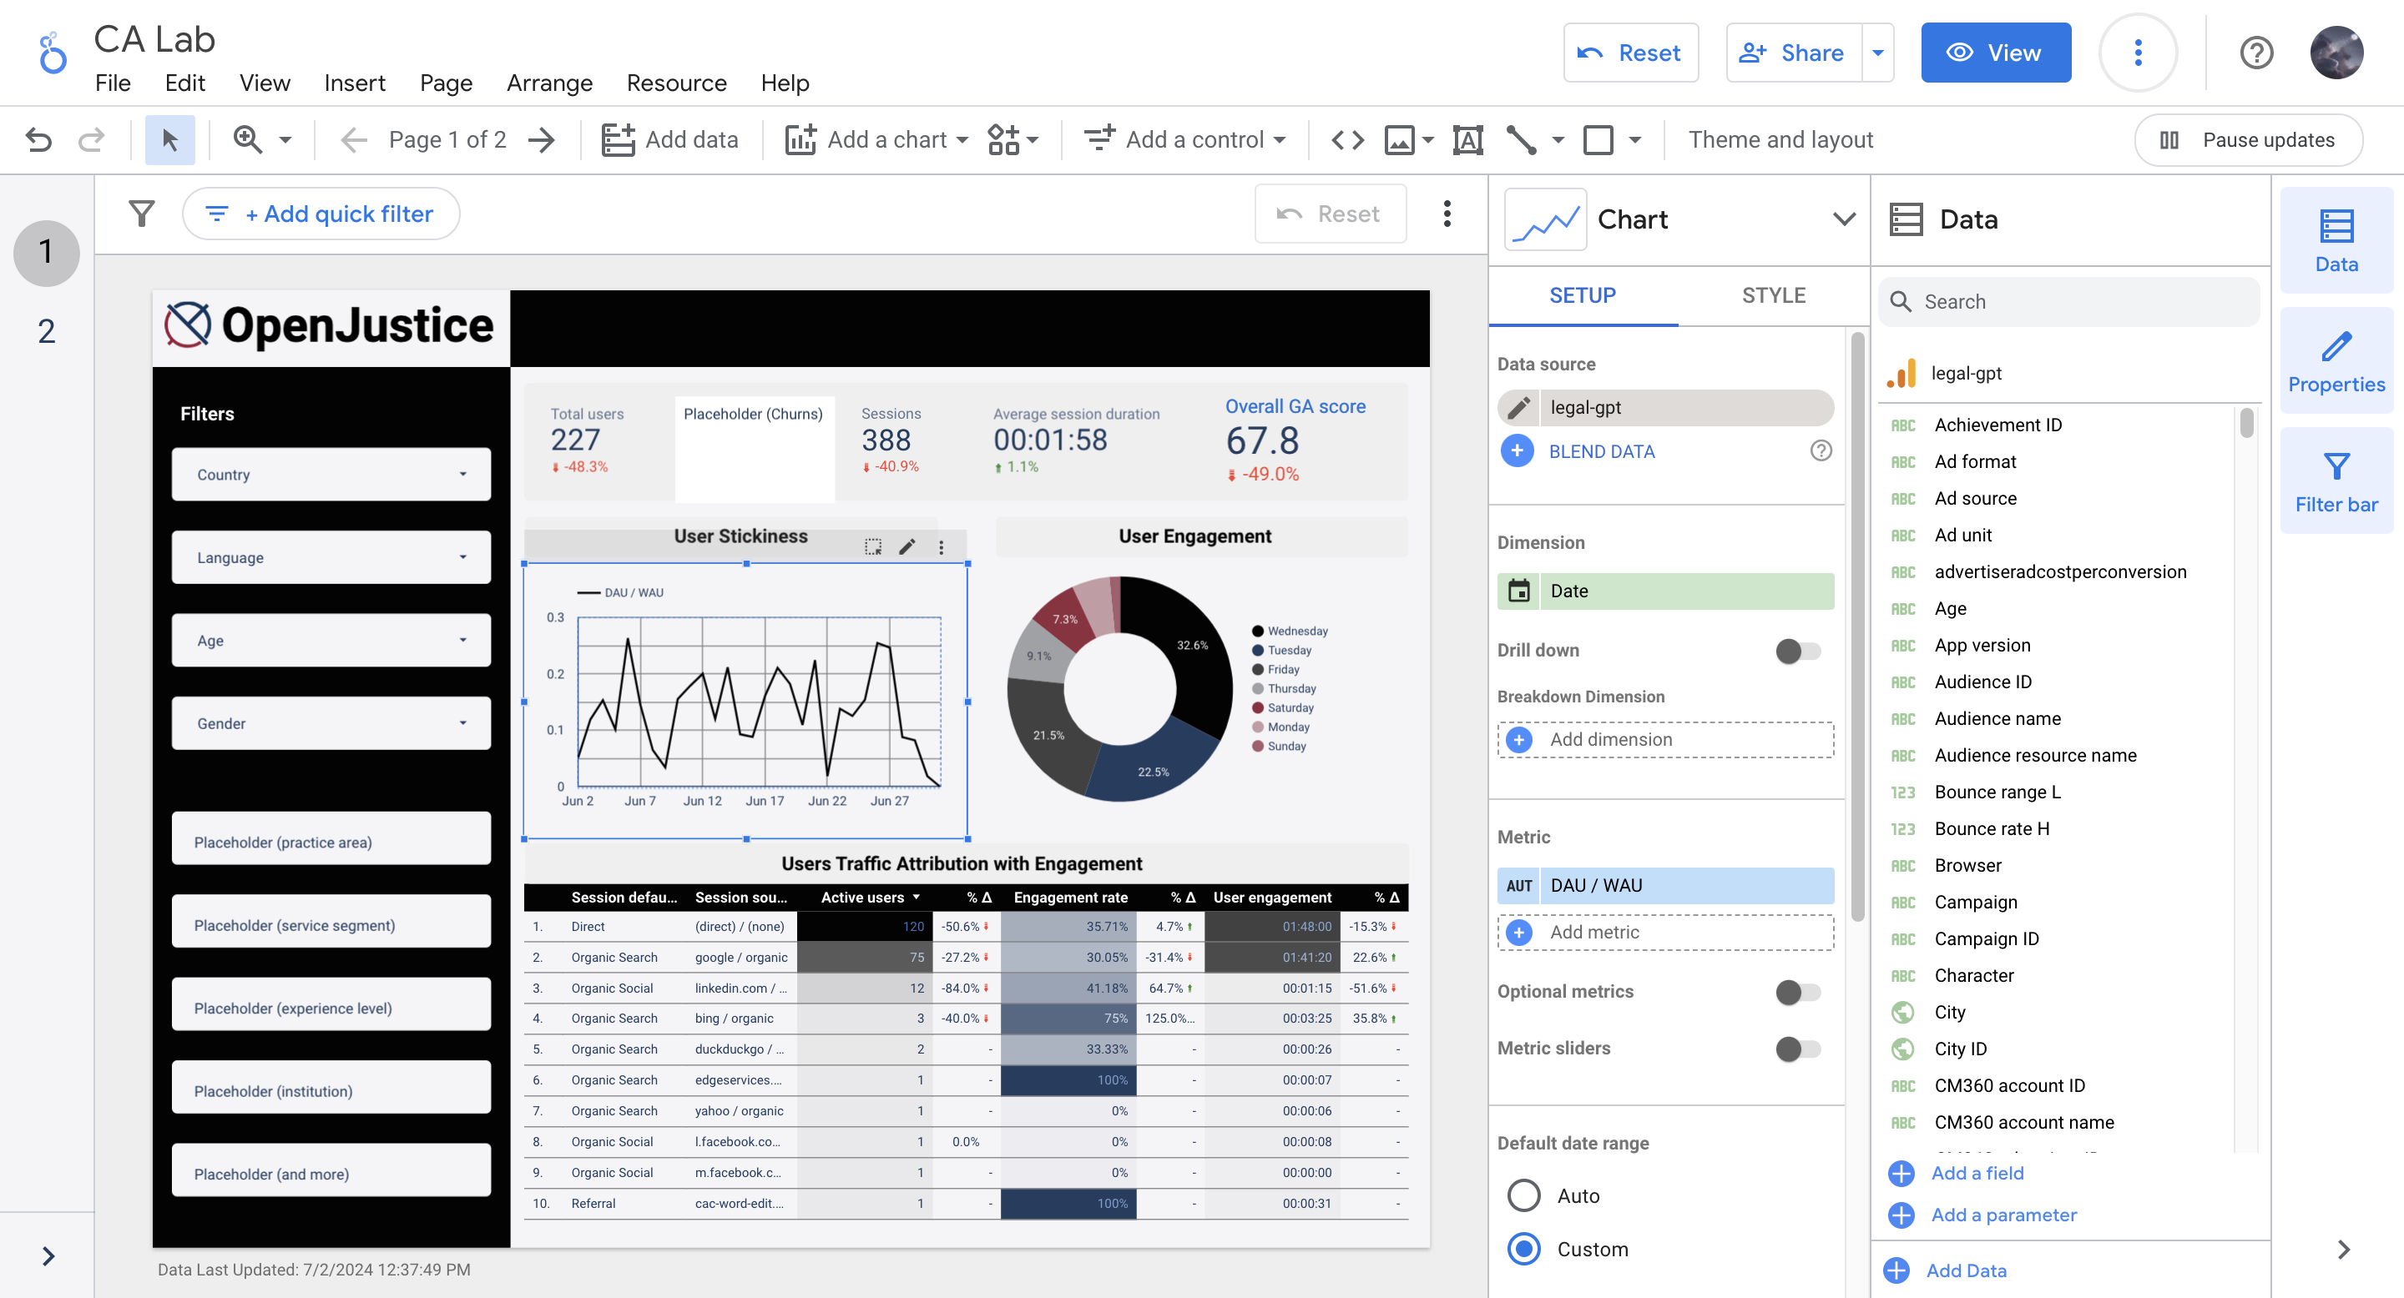
Page 1: Line Chart
** The time range is now set to the last 30 days, and they can be changed.
3
To edit:
The same way to adjust time range on the right Control bar, change "Default date range"
Change "Dimension" to choose display date, month, and so on
To use:
Move the mouse to a certain point will show the value of a certain date

Slide 8
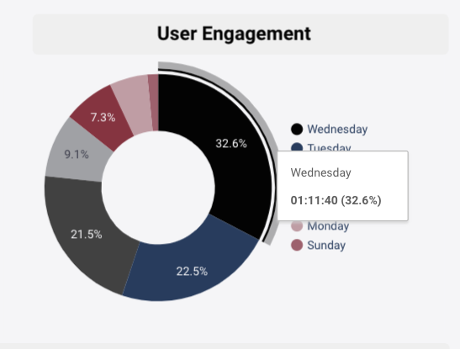
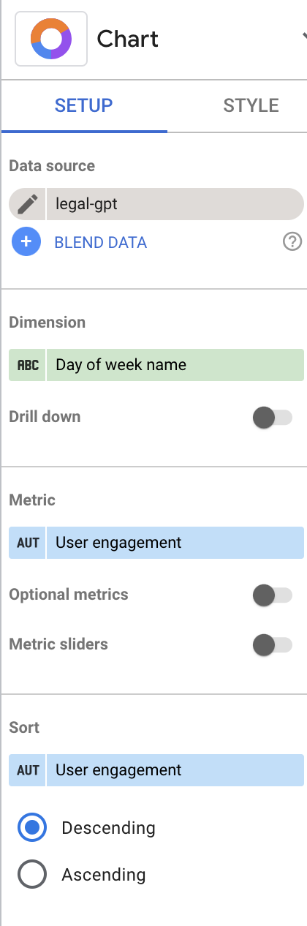
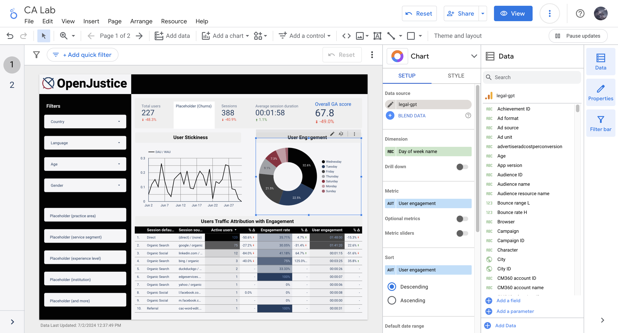
Page 1: Pie Chart
** The time range is now set to the last 30 days, and they can be changed.
4
To edit:
The same way to adjust time range on the right Control bar, change "Default date range"
Change "Dimension" to choose to display the engagement time by different categories
To use:
Move the mouse to a certain part will show the value of a certain day of the week

Slide 9
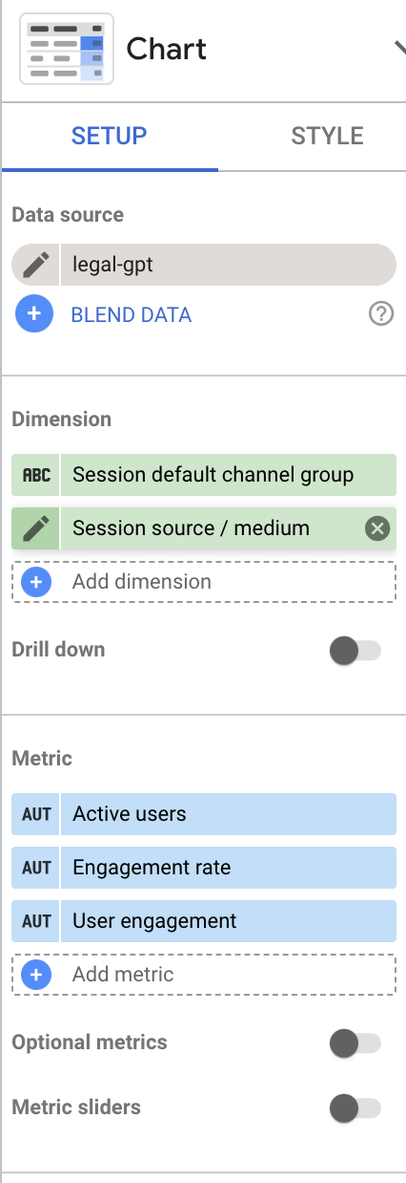
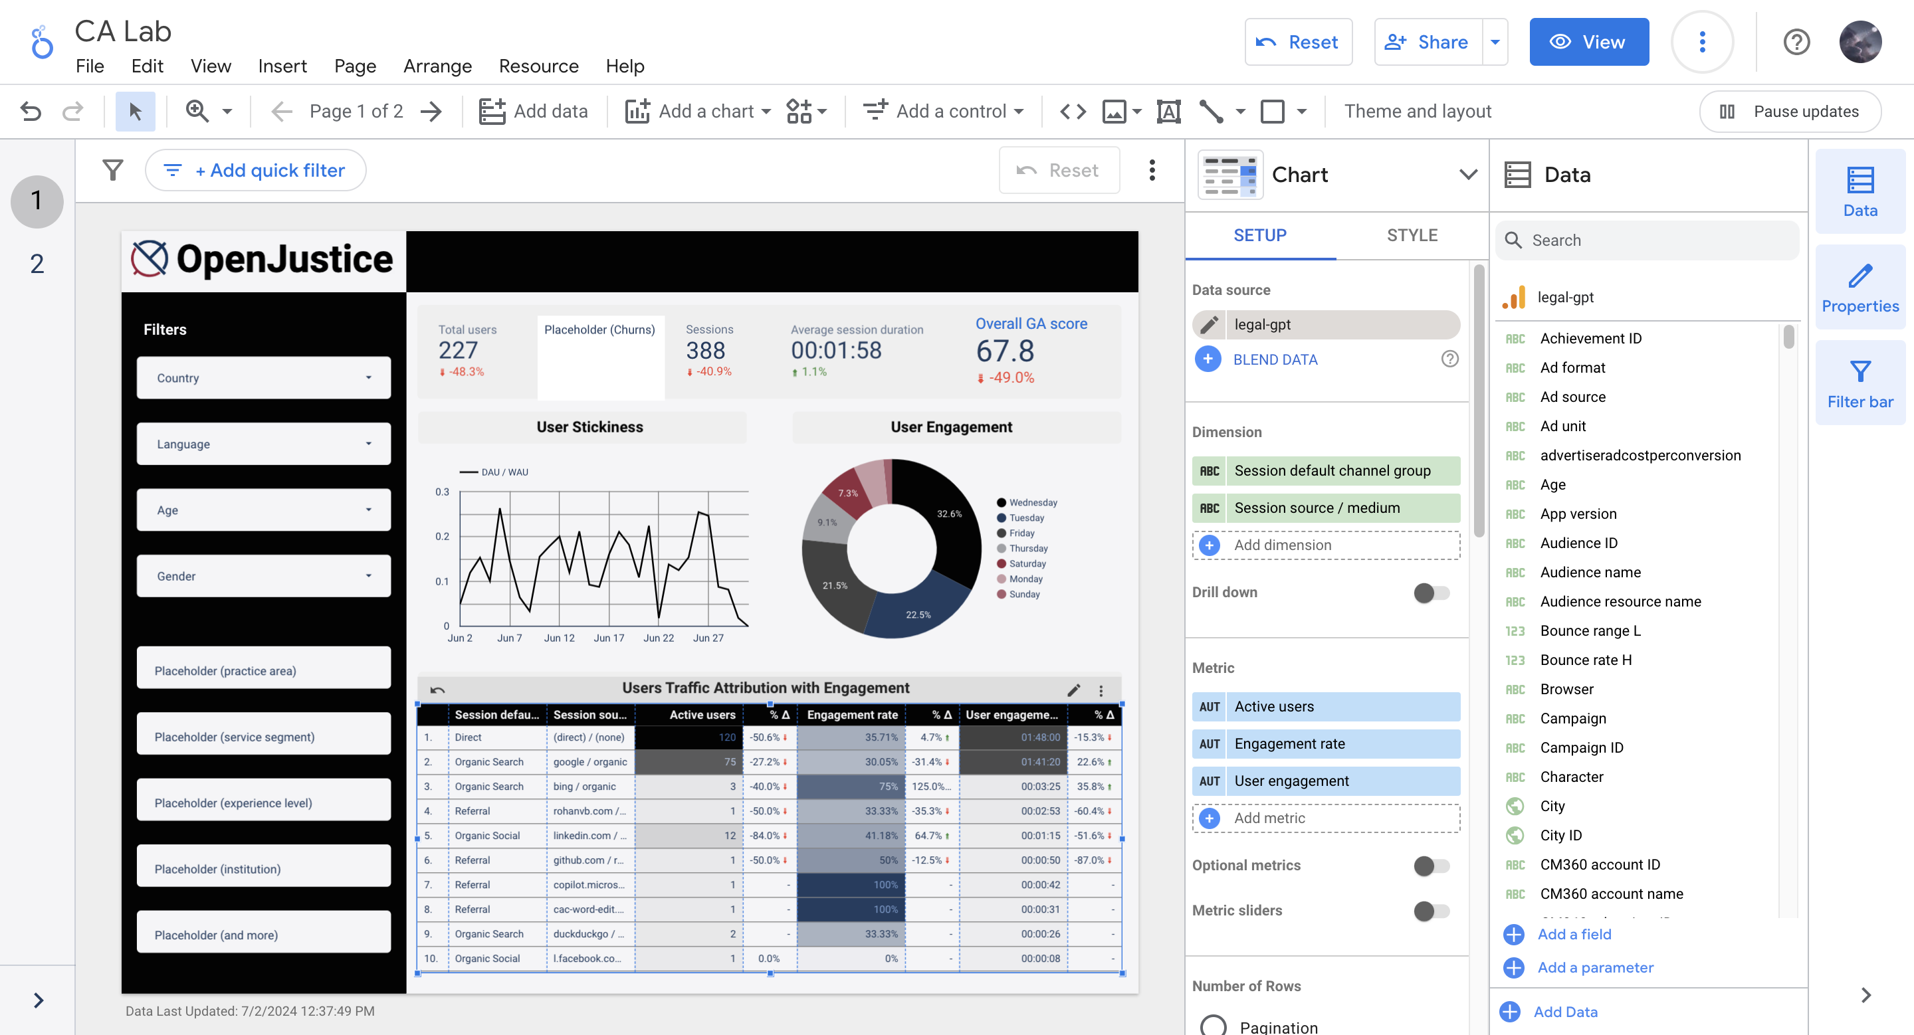
Page 1: Table
Session default channel group: the channels by which users arrived at the site when they initiated new sessions
Sessions source and medium: source is where the website's traffic comes from (individual websites, Google, Facebook etc). Medium is how it got there (organic traffic, paid traffic, referral etc), which can help understand where our users came from
Active users
Engagement rate: the percentage of engaged sessions
User engagement
** The time range is now set to the last 30 days, and they can be changed.
To edit:
The same way to adjust time range on the right Control bar, change "Default date range"
Change what dimensions and metric to include
5

Slide 10
Page 2: Overview
Scorecards:
Important KPIs used to calculate the Overall GA score, each contains data for the past 30 days with a comparison of the last period
2
Filters:
The same filter as page 1
1
3
Overall GA score over time:
Now, it uses 4 KPIs and weights of New users (20%), Engaged sessions (20%), Engagement rate (30%), and Bounce rate (30%) to calculate the score. The KPIs used and weights assigned can be changed
User maps:
The visualization of the user distribution geographically, and larger dot represents a higher density. The map will zoom in if a certain country is selected from the filter on the left
4

Slide 11
Page 2: Scorecards
New users
Engaged sessions: a session that lasts longer than 10 seconds, has a key event**, or has at least 2 pageviews or screen views
Engagement rate
Bounce rate: the percentage of sessions that were not engaged
Retention rate: shows the percentage of users who return each day in their first 42 days
Conversion rate: the percentage of users who complete a desired action (e.g., sign up, make an engagement)
2
** A key event is an event that measures an action that's particularly important to the success of business

Slide 12
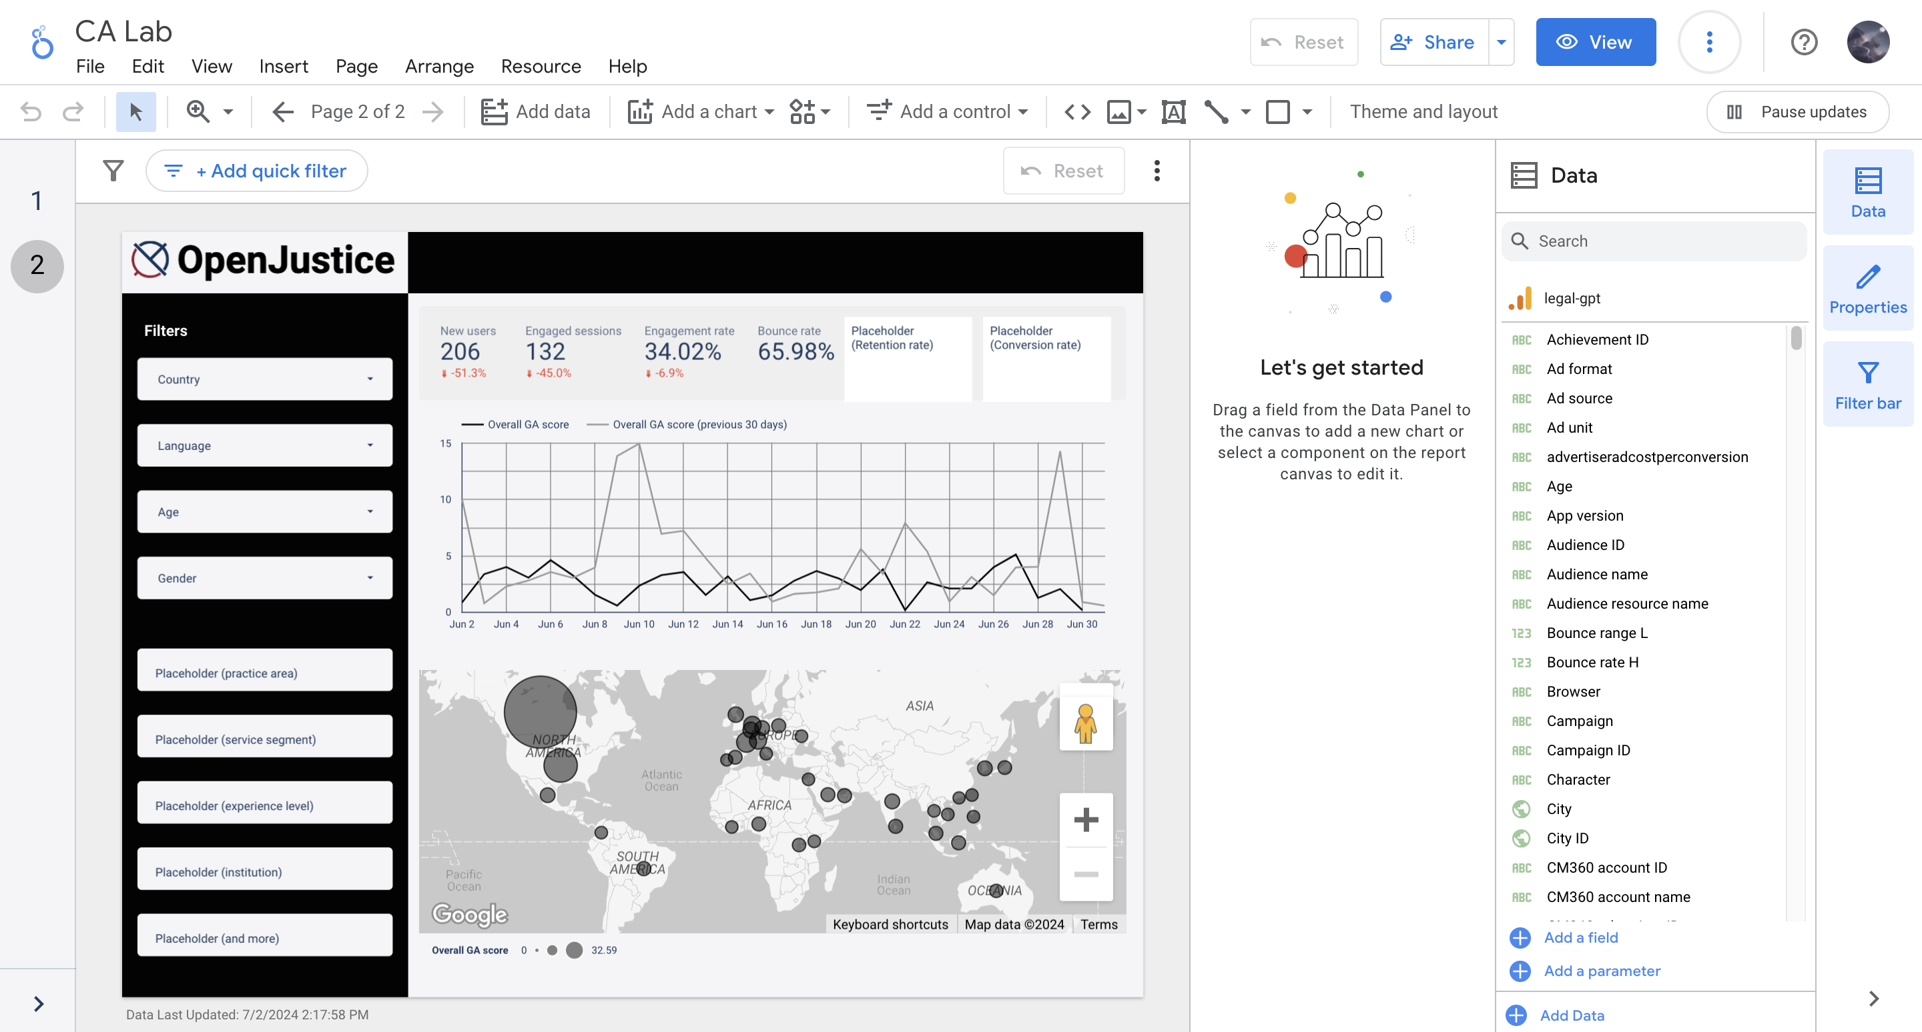
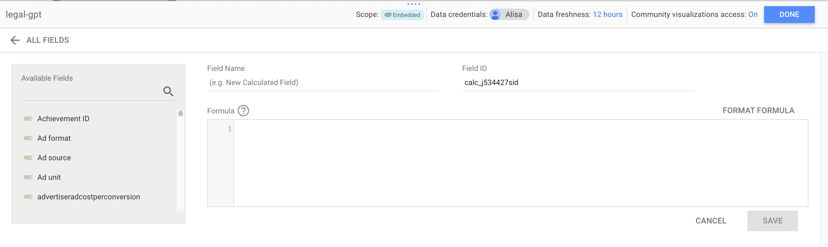
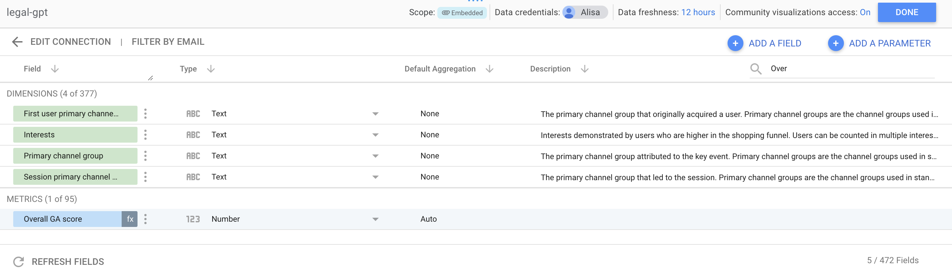
Creating New Field (e.g. Overall GA score)
On the right where displays the data source:
Add a field -> Add calculated field After filling the Formula, click on SAVE and then DONE
To modify, delete a Field:
Click on ALL FIELDS
Search the Field we want to change
Click the dots on the right to remove it
Click on the fx to modify the formula

